Slide 1
BiteBuddy ER Diagrams

Slide 2
Team2 : BiteBuddy
List of Entities
Entity Name | Entity Primary Attributes
Users | user_id, fullName, email, password, type, restaurant_id, city, street_address, zip_code
Restaurant | Restaurant_id, name, address, city, restaurant_type
Menu_items | Item_id, restaurant_id, name, price
Orders | order_id, user_id, restaurant_id, items, total
Reservations | reservation_id, restaurant_id, customer_email, date, guests
Payments | payment_id , order_id , amount, payment_method, status, payment_type
Commissions | commission_id , restaurant_id , order_id , commission_amount, date
Sponsored_Listings | listing_id , restaurant_id , start_date, end_date, amount_paid
Financial_Accounts | fin_id , restaurant_id , balance, last_transaction_date, account_status
Feedback | Feedback_id , user_id , restaurant_id , comments, rating
Support_Tickets | ticket_id , user_id , issue_type, description, status

Slide 3
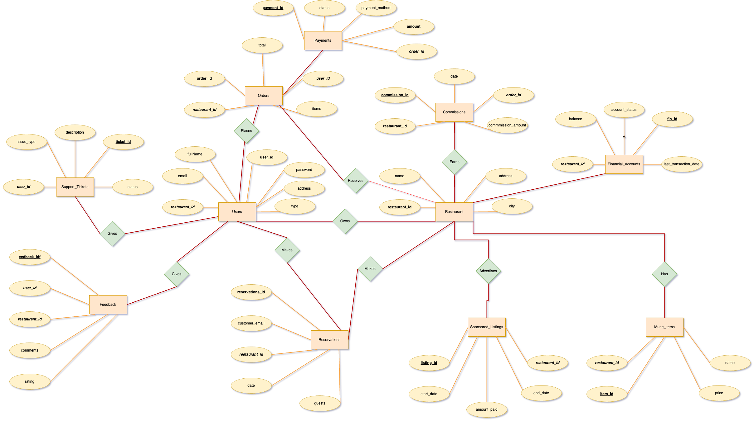
Team2 : BiteBuddy
Conceptual ER Diagram
NOTE: PK: BOLD & UNDERLINE
FK: BOLD & ITALIC

Slide 4
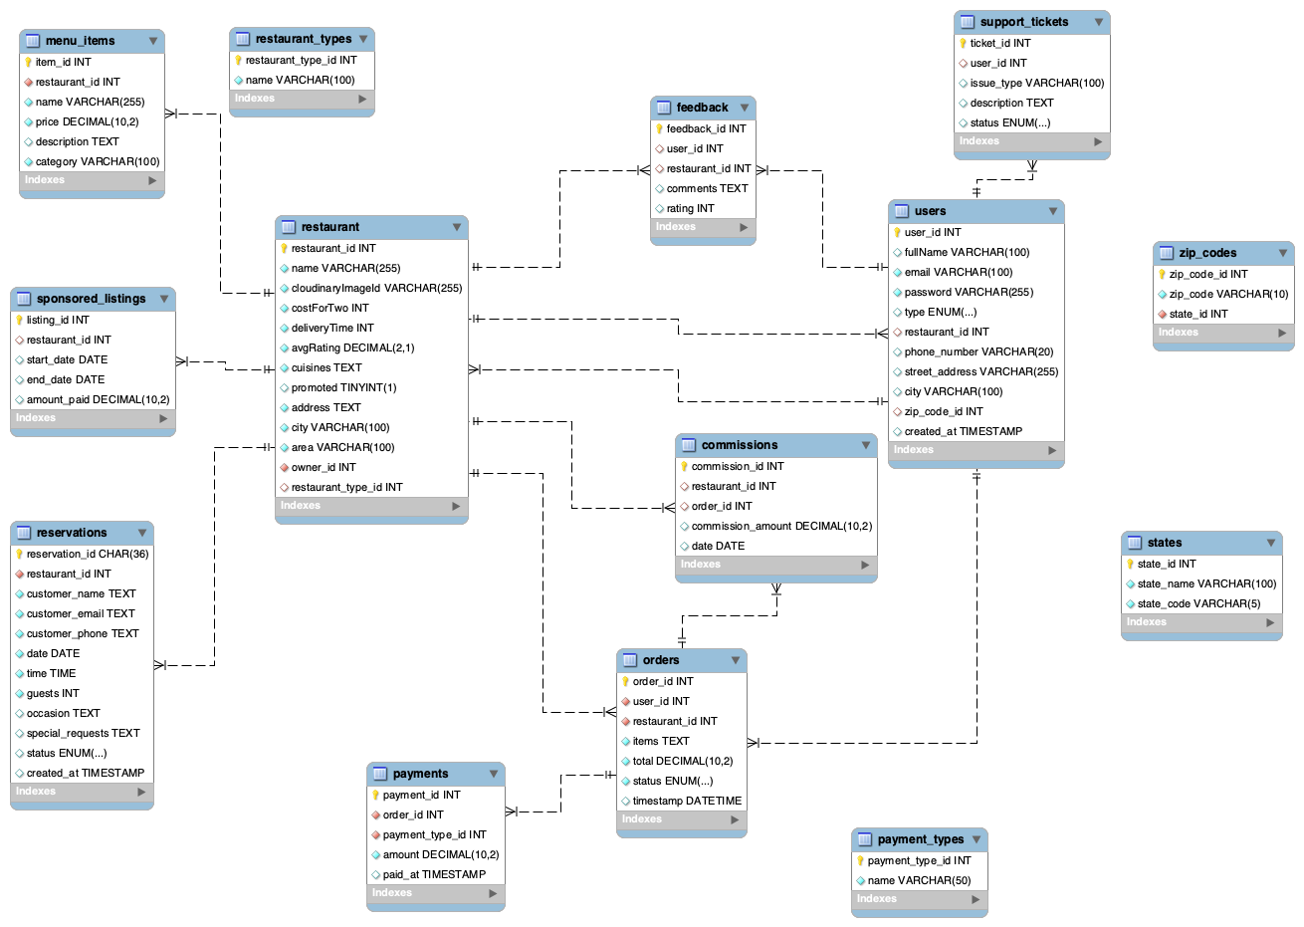


Team2 : BiteBuddy
Logical ER Diagram
Reference table
Reference table
Reference table
Reference table
NOTE:
Primary key
Foreign key

